Slide 1


GeoTol Pro 2020
Fundamentals Training Program
Applications Drag and Drop Template
GeoTol Inc. © 2021

Slide 2
Tips
Make a copy of each object before using it.
Alt codes are in the lower left. Hold the alt key and type in the numerical code and then release the alt key.
When grabbing the MMC, LMC or Projected symbols try to grab the circle or the grouping won’t keep the symbol together
After building your Feature Control Frame (FCF), drag a bounding box and group it to make moving it easier
Arrows. Grab the leader that looks closest to what you need. Once you have it you can click on the arrowhead and move the arrowhead for finer placement
Use the “Copy Text” or “.000” for your text boxes
When pasting your image, rt click and send to back

Slide 3
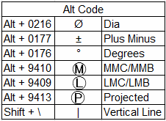
A
B
C
Ø .004 Ⓜ | A | B | C
A
A B
A B C
Ⓟ
Ⓜ
Ø
Ⓛ
.000
Copy this text

